Slide 1

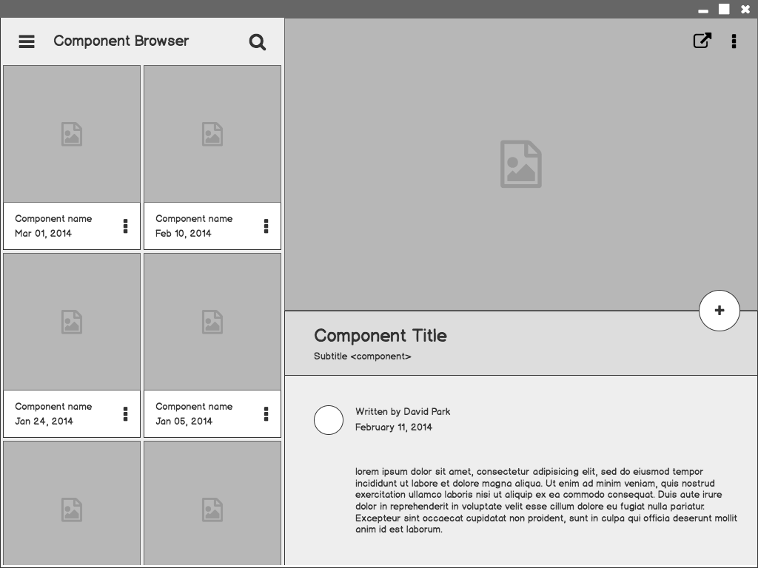
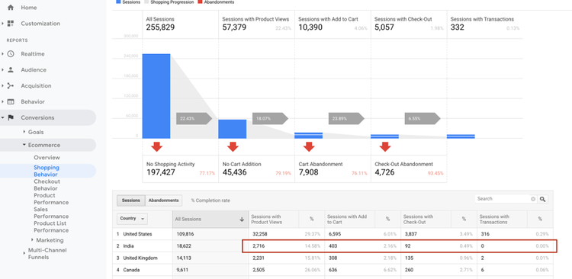

Retail
Analysis
Performance Optimization of Ecommerce Store
We are an E-Commerce Company that is continuously working on Performance Optimization of Ecommerce Store
With the help of given data, did analysis to draw the insights about

Slide 2
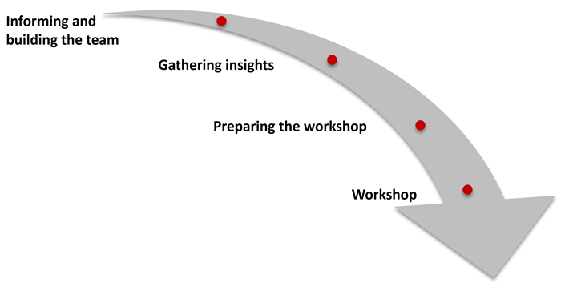
PROJECT JOURNEY
Data Gathering & building team
Use SQL to refine data
Gathering Insights
Dashboard

Slide 3
Project Motivation
In this project we focused retail analysis with App data and answer the following questions:
“Daily_logins” which contains the number of logins on a daily basis
Daily trend of logins and trend of conversion rate (Number of orders placed per login)
Which KPIs would you use to measure the performance of our app?
report regarding our growth between the 2 years
What are our top-selling products in each of the two years? Can you draw some insight
Looking at July 2021 data, what do you think is our biggest problem and how would you recommend fixing it?
Does the login frequency affect the number of orders made?
Give at least 2 insights that are not mentioned above and are not clearly visible from the data.

Slide 4
Installation & Implementation
SQL
In this project, we used SQL and Power Query to Analyse the Data
Data
There are retail data available of APP. This is the data that covers retail in 2021-July to 2022 July
Result
The details of the results show in the code, insights & Dashboard.

Slide 5
Key Insights
Based on the data that we have obtained through SQL queries, we can conclude that:
App performance increased significantly in the 2022 year, as seen from the value of sales and No of orders which increased by 24.6% and 30.5%
The acquisition of new customers is very good, and increased compared to the previous year.
The interest of new customers to shop old products is loosed. It is recommended that the Product team need to study customer behaviour and make product improvements, so that the conversion rate (register to transaction) can increase.

Slide 6
Products categories 12547 and 10235 contribute highest of total orders in 2022 & 2021, so App team should focus on developing the 12547 and 10235 categories.
App product order retention rate is low at only meaning that many customers who have transacted in the 2021 year do not return to place order in the 2022 year (no repeat orders).
App experienced positive growth in the 2022 year and needs to make a lot of improvements both in terms of products and marketing business, if it wants to achieve its target and positive growth in the 2023 quarter.
The low retention rate and conversion rate can be an early diagnosis that customers are not interested/unsatisfied/disappointed in shopping at that App.

Slide 7
Unique Findings
Low Retention rate
Low Conversion rate
Need to study customer behavior
Need to make product improvements

Slide 8
Learnings
Retrieve & Implement on future projects
Identify
Analyse & create Reports
Team work & how to deal with project deadline

Slide 9
Challenges
The Reason for Rejection of large number of orders.
Reason of low profit in 2021.
There is No Repeat Customers Data Available.
Too much variation in Order placements.
Rate of new customer acquisition is low.
1

Slide 10
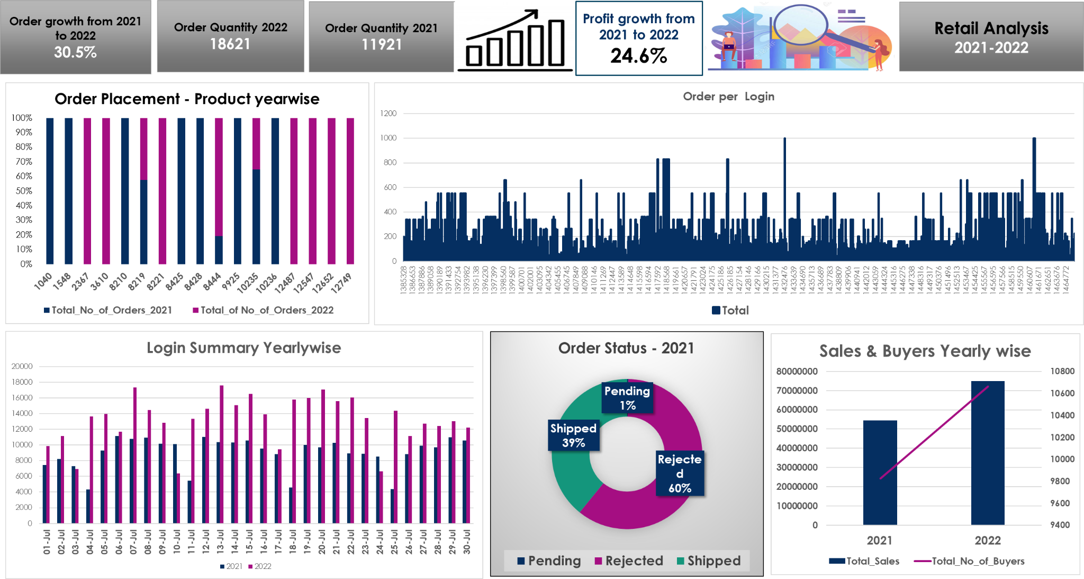

Slide 11
Thank you

